Slide 1
Developing Microservices
Dominik Sachsenhofer (@sachsenhofer) - Strategic Alliances and Innovation - August 2018

Slide 2
What you will learn in this session: Develop and deploy a Microservices Application on a Kubernetes Cluster

Slide 3
Outline
Introduction
Part 1: Container and containerized apps (Docker)
Part 2: Using a Container Registry (Google Container Registry)
Part 3: Create a Microservices application
Part 4: Create a Kubernetes Cluster (Google Kubernetes Engine)
Part 5: Deploy a microservice application on a Kubernetes Cluster
Part 6: Instrument a Kubernetes Cluster with Dynatrace (Dynatrace One-Agent Operator)
Recap

Slide 4
Clone repository: git clone https://github.com/dynatrace-innovationlab/developing-microservices

Slide 5
Part 1: Container and containerized apps

Slide 6
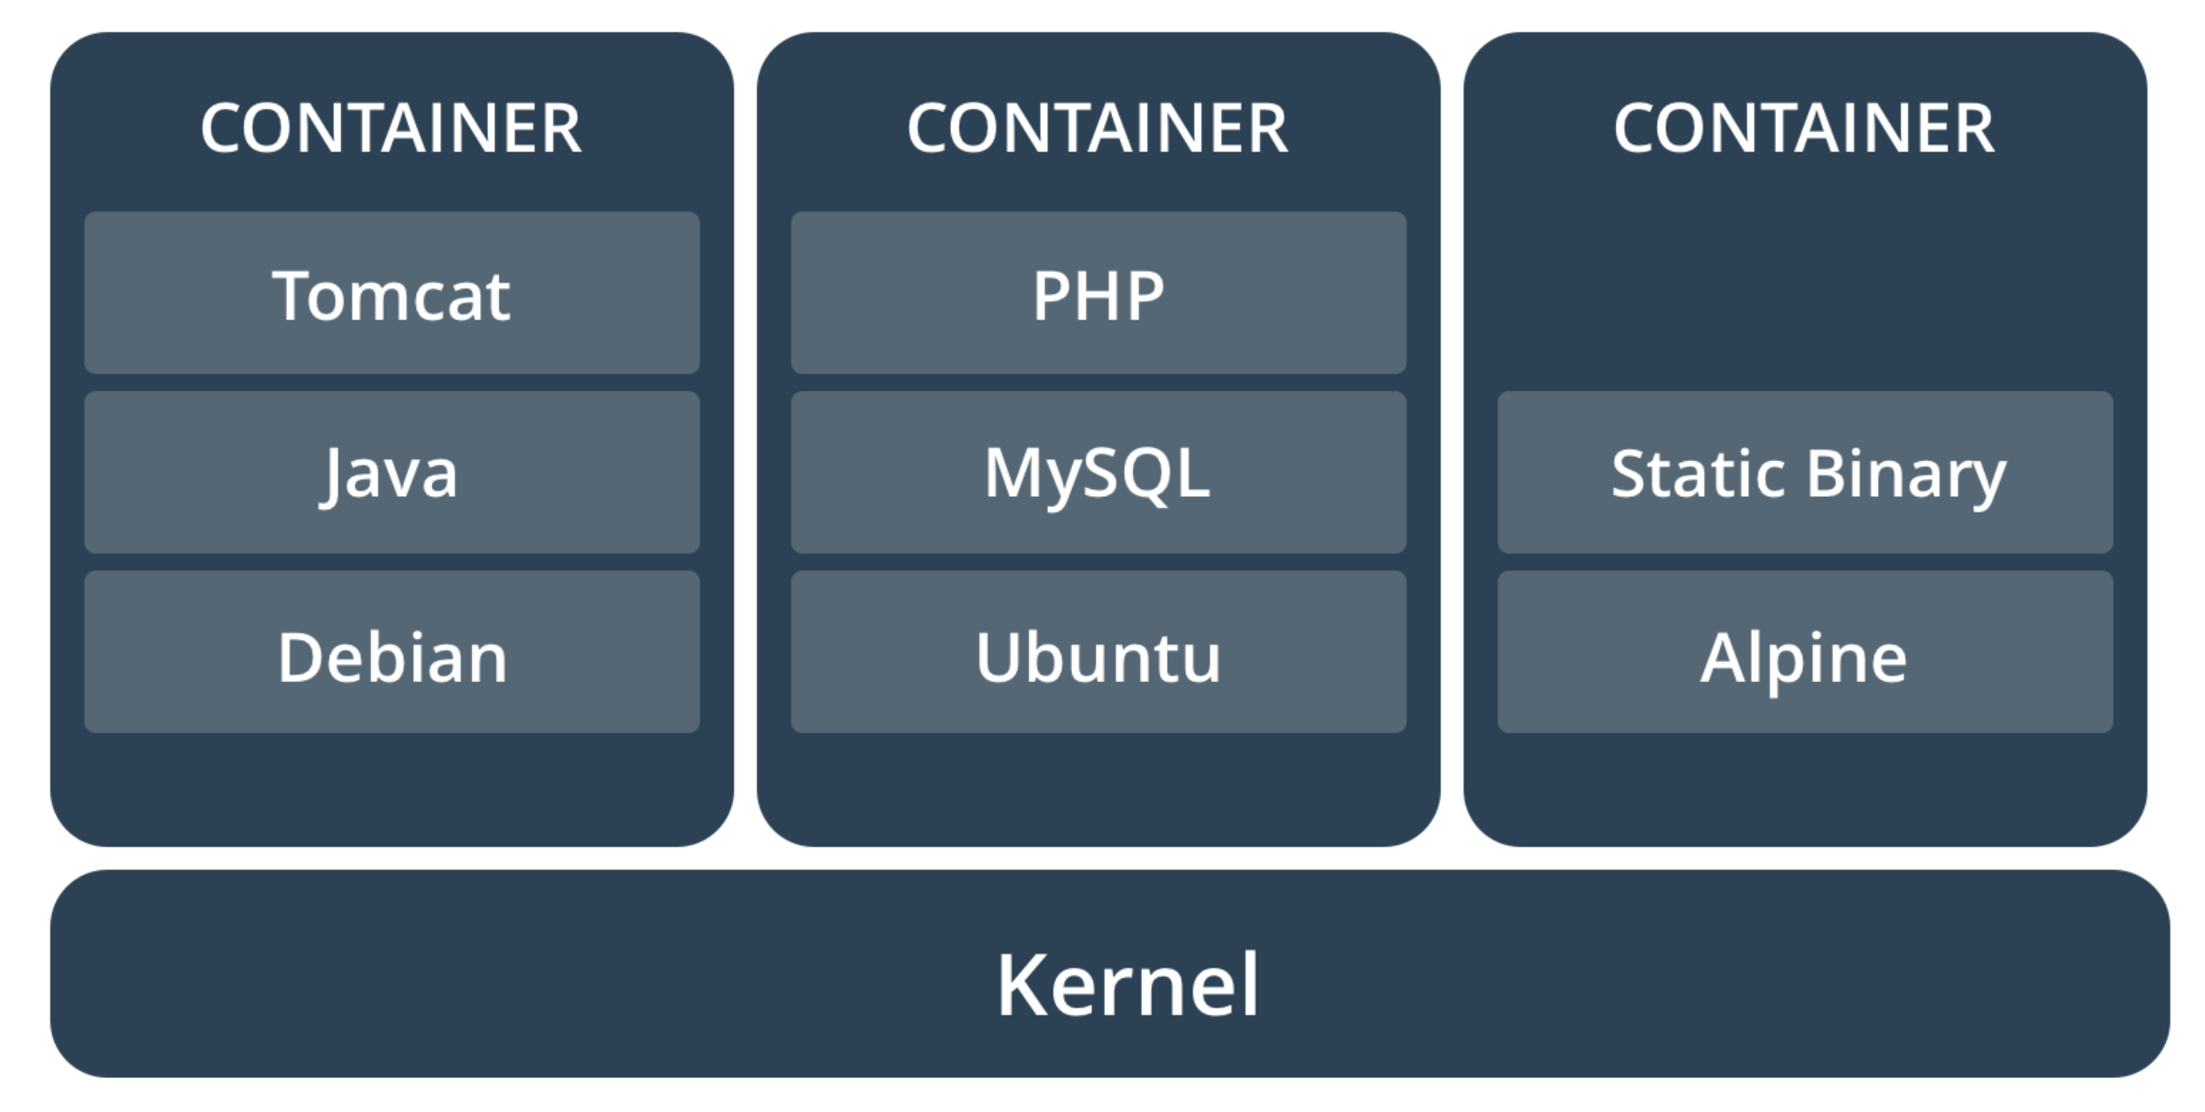
What is a Container?
A container (image) is a lightweight, stand-alone, executable package of software that includes everything needed to run it: code, runtime, system tools, system libraries, settings.

Slide 7
Comparing Containers and Virtual Machines
Containers and virtual machines have similar resource isolation and allocation benefits, but function differently because containers virtualize the operating system instead of hardware. Containers are more portable and efficient.

Slide 8
Create a containerized Python Web application
Step 1/5: Create a Python Web application:
File: directory/app.py
from flask import Flask app = Flask(__name__)
@app.route("/") def hello():
return "Hello World!”
if __name__ == '__main__‘:
app.run(debug=False, host='0.0.0.0', port=8080)

Slide 9
Create a containerized Python Web application
Step 2/5: Create a requirements.txt:
File: directory/requirements.txt
flask==0.10.1

Slide 10
Create a containerized Python Web application
Step 3/5: Create a Dockerfile:
File: directory/Dockerfile
FROM ubuntu:latest
RUN apt-get update
RUN apt-get install -y python-pip python-dev build-essential wget curl
COPY . /app
WORKDIR /app
RUN pip install -r requirements.txt
EXPOSE 8080
ENTRYPOINT ["python"]
CMD ["app.py"]

Slide 11
Create a containerized Python Web application
Step 4/5: Build the Docker container:
$ docker build –t sai-research/hello-world:latest .

Slide 12
Create a containerized Python Web application
Step 5/5: Run the Docker container:
$ docker run –p 8080:8080 sai-research/hello-world:latest

Slide 13
Lab 1: Create a containerized Python web application

Slide 14
Part 2: Using a Container Registry

Slide 15
What is a Container Registry?
In a Container Registry you can store, manage, and secure your Docker container images.
Container Registry Features:
Vulnerability Scanning
Container Tags
Automated Build Triggers

Slide 16
Pull/Push images from/to a Container Registry
Step 1/4: Build the image:
$ sudo docker build -t sai-research/hello-world:latest .

Slide 17
Pull/Push images from/to a Container Registry
Step 2/4: Tag the image:
$ sudo docker tag sai-research/hello-world:latest eu.gcr.io/sai-research/hello-world:latest

Slide 18
Pull/Push images from/to a Container Registry
Step 3/4: Push the image to the Container Registry:
$ sudo docker push eu.gcr.io/sai-research/hello-world:latest

Slide 19
Pull/Push images from/to a Container Registry
Step 4/4: Pull the image from the Container Registry:
$ sudo docker pull eu.gcr.io/sai-research/hello-world:latest

Slide 20
Lab 2: Pull/Push images from/to a Container Registry

Slide 21
Part 3: Create a microservices application

Slide 22
Define the application
TODO APP

Slide 23
Define the microservices/architecture
UI
~ Frontend
~ Backend
~ Database
Technologies: Node.js/Express.js
Image: alpine
USER
TASK
Technologies: Python/Flask
Technologies: Python/Flask
Image: ubuntu
Image: ubuntu
USER DB
TASK DB
Technologies: MongoDB
Technologies: MongoDB
Image: mongo
Image: mongo

Slide 24
Define the endpoints
UI
UI Endpoints:
http://todo-ui-svc:8080
http://todo-ui-svc:8080/dashboard
http://todo-ui-svc:8080/task/add_task
http://todo-ui-svc:8080/task/delete_task
http://todo-ui-svc:8080/user/register
http://todo-ui-svc:8080/user/signin
http://todo-ui-svc:8080/user/signout
Technologies: Node.js/Express.js
Image: alpine
USER
TASK
Technologies: Python/Flask
Technologies: Python/Flask
Image: ubuntu
Image: ubuntu
USER DB
TASK DB
Technologies: MongoDB
Technologies: MongoDB
Image: mongo
Image: mongo

Slide 25
Define the endpoints
UI
USER Endpoints:
http://todo-user-svc:8080
http://todo-user-svc:8080/health
http://todo-user-svc:8080/register_user
http://todo-user-svc:8080/delete_user
http://todo-user-svc:8080/list_users
Technologies: Node.js/Express.js
Image: alpine
USER
TASK
Technologies: Python/Flask
Technologies: Python/Flask
Image: ubuntu
Image: ubuntu
USER DB
TASK DB
Technologies: MongoDB
Technologies: MongoDB
Image: mongo
Image: mongo

Slide 26
Define the endpoints
UI
USER DB Endpoints:
mongodb://todo-user-db-svc:27017
Technologies: Node.js/Express.js
Image: alpine
USER
TASK
Technologies: Python/Flask
Technologies: Python/Flask
Image: ubuntu
Image: ubuntu
USER DB
TASK DB
Technologies: MongoDB
Technologies: MongoDB
Image: mongo
Image: mongo

Slide 27
Define the endpoints
UI
TASK Endpoints:
http://todo-task-svc:8080
http://todo-task-svc:8080/health
http://todo-task-svc:8080/add_task
http://todo-task-svc:8080/delete_task
http://todo-task-svc:8080/list_tasks
Technologies: Node.js/Express.js
Image: alpine
USER
TASK
Technologies: Python/Flask
Technologies: Python/Flask
Image: ubuntu
Image: ubuntu
USER DB
TASK DB
Technologies: MongoDB
Technologies: MongoDB
Image: mongo
Image: mongo

Slide 28
Define the endpoints
UI
TASK DB Endpoints:
mongodb://todo-task-db-svc:27017
Technologies: Node.js/Express.js
Image: alpine
USER
TASK
Technologies: Python/Flask
Technologies: Python/Flask
Image: ubuntu
Image: ubuntu
USER DB
TASK DB
Technologies: MongoDB
Technologies: MongoDB
Image: mongo
Image: mongo

Slide 29
Lab 3: Create a microservices application

Slide 30
Part 4: Create a Kubernetes Cluster

Slide 31
What is Kubernetes?
Kubernetes is an open-source system for automating deployment, scaling, and management of containerized applications
MASTER NODE
Kubernetes API
…
WORKER NODE 1
WORKER NODE 2
WORKER NODE 3
kubelet
kubelet
kubelet
…
…
…

Slide 32
What is a … in Kubernetes?
Service
Deployment
StatefulSets
DaemonSet
ReplicaSet
Jobs
CronJob
Pod

Slide 33
Features of Kubernetes
Automatic binpacking
Self-healing
Horizontal Scaling
Service discovery and load balancing
Automated rollouts and rollbacks
Secret and configuration management
Storage orchestration
Batch execution

Slide 34
Lab 4: Create a Kubernetes Cluster

Slide 35
Part 5: Deploy a microservices application on a Kubernetes Cluster

Slide 36
How to deploy a microservice on Kubernetes?
Step 1/4: Create a configuration (.yaml Files)
TODO UI
(Container/Image)
+
SERVICE
(todo-ui-svc.yaml)
eu.gcr.io/sai-research/todo-ui:latest
svc/todo-ui
DEPLOYMENT
(todo-ui-dep.yaml)
dep/todo-ui

Slide 37
How to deploy a microservice on Kubernetes?
Step 2/4: Create a deployment configuration (todo-ui-dep.yaml)
apiVersion: apps/v1
kind: Deployment
metadata:
name: todo-ui-dep
labels: app: todo-ui
namespace: todo
spec:
replicas: 1
selector:
matchLabels:
app: todo-ui
template:
metadata:
labels:
app: todo-ui
spec:
containers:
- image: eu.gcr.io/sai-research/microservice-todo-ui:latest
name: todo-ui
ports:
- containerPort: 8080
env:
- name: TODO_TASK_SVC
value: "http://todo-task-svc:8080"
- name: TODO_USER_SVC
value: "http://todo-user-svc:8080"
Name
Replicas
Container/Image
Environment variables

Slide 38
How to deploy a microservice on Kubernetes?
Step 3/4: Create a service configuration (todo-ui-svc.yaml)
kind: Service
apiVersion: v1
metadata:
name: todo-ui-svc
namespace: todo
spec:
selector:
app: todo-ui
ports:
- protocol: TCP
port: 8080
targetPort: 8080
type: LoadBalancer
Name
Port
Type

Slide 39
How to deploy a microservice on Kubernetes?
Step 4/4: Execute the configuration (.yaml Files)
$ kubectl create –f todo-ui-dep.yaml
$ kubectl create –f todo-ui-svc.yaml

Slide 40
How to deploy a microservices application on Kubernetes?
TODO UI
(Container/Image)
+
SERVICE (todo-ui-svc.yaml)
DEPLOYMENT (todo-ui-dep.yaml)
TODO USER
(Container/Image)
+
SERVICE (todo-user-svc.yaml)
DEPLOYMENT (todo-user-dep.yaml)
TODO USER DB
(Container/Image)
+
SERVICE (todo-user-db-svc.yaml)
DEPLOYMENT (todo-user-db-dep.yaml)
TODO TASK
(Container/Image)
+
SERVICE (todo-task-svc.yaml)
DEPLOYMENT (todo-task-dep.yaml)
TODO TASK DB
(Container/Image)
+
SERVICE (todo-task-db-svc.yaml)
DEPLOYMENT (todo-task-db-dep.yaml)

Slide 41
Lab 5: Deploy a microservices application on a Kubernetes Cluster

Slide 42
Part 6: Instrument a Kubernetes Cluster with Dynatrace

Slide 43
How the instrumentation works
Step 1/1: Install Dynatrace One-Agent Operator
KUBERNETES CLUSTER
+
Node 1
DYNATRACE ONEAGENT OPERATOR
Node 2
Node 3
Type: DaemonSet
…
https://github.com/Dynatrace/dynatrace-oneagent-operator
Node n

Slide 44
Lab 6: Instrument a Kubernetes Cluster with Dynatrace

Slide 45
Questions/Answers/Feedback Q/A

Slide 46
Deliver high performance to your customers

Slide 47
Build better software faster

Slide 48
Analyze user behavior to optimize customer experience

Slide 49
Compare behavior and conversions across all channels

Slide 50
Use a single platform to analyze application performance throughout your application’s full stack

Slide 51
Be the one who monitors

Slide 52
Easy access to global experts

Slide 53
Application performance monitoring for retail & ecommerce

Slide 54
Cloud monitoring taken to the next level

Slide 55
Dynatrace would have told you!

Slide 56





Slide 57




Slide 58
Get the latest icons from the asset library! http://assets.dynatrace.vmta

